Slide 1
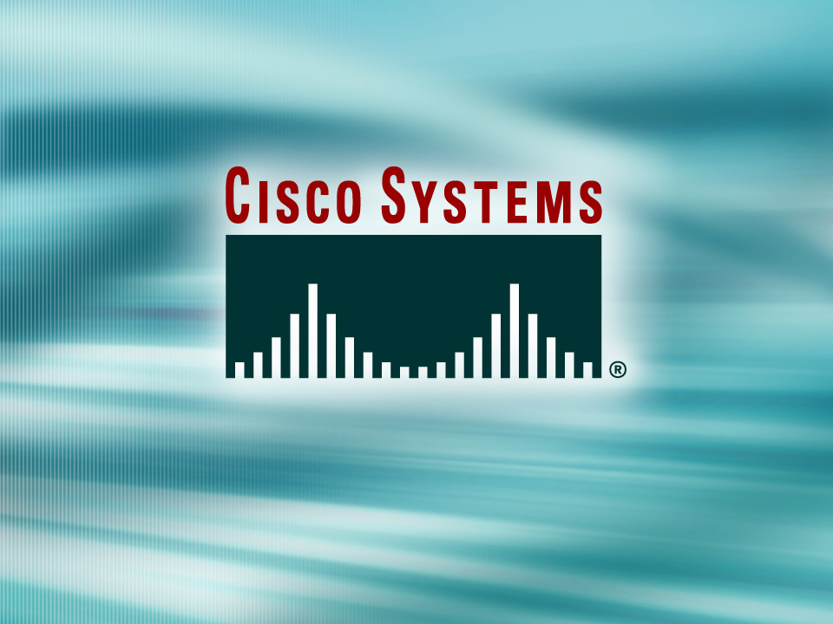
© 2002, Cisco Systems, Inc. All rights reserved.

Slide 2
Establishing Frame Relay Connections
Module 8
Notes:
Purpose: This chapter introduces the Cisco IOS™ CLI on the Catalyst® 1900 switch and router.
Timing: This chapter should take about 2 hours to present.
Note: The Catalyst 1900 switch only has a subset of the router Cisco IOS commands available.
Contents:
Introduction to Cisco IOS. Explain to the student what is IOS?
Cisco Device startup procedures in general.
IOS configuration source.
General introduction to the IOS CLI.
Cat 1900 switch startup procedures.
Intro to Cat 1900 CLI. This part covers the basic configuration on the switch, like setting the IP address and hostname. More details about the various Cat 1900 switch configuration commands are explained in Chapter 6 and 7.
Router startup procedures. More details on the router startup process is discussed in chapter 5.
Router IOS CLI.

Slide 3
Objectives
Upon completing this module, you will be
able to:
  Use Cisco IOS commands to configure an operational serial Frame Relay connection and Frame Relay subinterfaces, given a functioning router
  Use show commands to identify anomalies in an operational serial Frame Relay connection and Frame Relay subinterfaces, given a functioning router
  Use debug commands to identify events and anomalies in an operational serial Frame Relay connection and Frame Relay subinterfaces, given a functioning router and an operational serial Frame Relay connection
Notes:
Slide 1 of 2
Purpose: This slide states the chapter objectives.
Emphasize: Read or state each objective so that each student has a clear understanding of the chapter objectives.
Note: Catalyst switches have different CLIs. The Catalyst 2900xl and the Catalyst 1900 has a Cisco IOS CLI. The Cisco IOS CLI commands available on the 2900xl is different from the 1900. The Catalyst 5000 family has no Cisco IOS CLI, and use the set commands instead. This class only covers the configuration on the Catalyst 1900 switch.

Slide 4

Frame Relay Overview
© 2002, Cisco Systems, Inc. All rights reserved.
Notes:
Purpose: This chapter introduces the Cisco IOS™ CLI on the Catalyst® 1900 switch and router.
Timing: This chapter should take about 2 hours to present.
Note: The Catalyst 1900 switch only has a subset of the router Cisco IOS commands available.
Contents:
Introduction to Cisco IOS. Explain to the student what is IOS?
Cisco Device startup procedures in general.
IOS configuration source.
General introduction to the IOS CLI.
Cat 1900 switch startup procedures.
Intro to Cat 1900 CLI. This part covers the basic configuration on the switch, like setting the IP address and hostname. More details about the various Cat 1900 switch configuration commands are explained in Chapter 6 and 7.
Router startup procedures. More details on the router startup process is discussed in chapter 5.
Router IOS CLI.

Slide 5
Objectives
Upon completing this lesson, you will be
able to:
  Describe the features and operation of a Frame Relay network
  Define important Frame Relay terms including local access rate, virtual circuit, PVC, SVC, DLCI, CIR, InARP, LMI, FECN, and BECN
Notes:
Slide 1 of 2
Purpose: This slide states the chapter objectives.
Emphasize: Read or state each objective so that each student has a clear understanding of the chapter objectives.
Note: Catalyst switches have different CLIs. The Catalyst 2900xl and the Catalyst 1900 has a Cisco IOS CLI. The Cisco IOS CLI commands available on the 2900xl is different from the 1900. The Catalyst 5000 family has no Cisco IOS CLI, and use the set commands instead. This class only covers the configuration on the Catalyst 1900 switch.

Slide 6
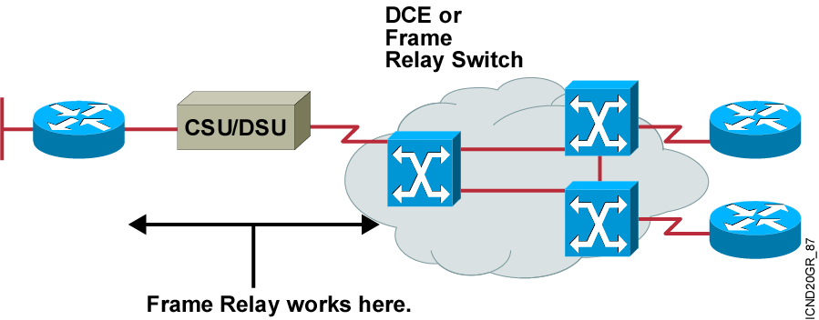
Frame Relay Overview
  Connections made by virtual circuits
  Connection-oriented service
Notes:
Purpose: This figure provides a big-picture definition of Frame Relay.
Emphasize: Frame Relay is used between the CPE device and the Frame Relay switch. It does NOT affect how packets get routed within the Frame Relay cloud.
Frame Relay is a purely Layer 2 protocol.
The network providing the Frame Relay service can be either a carrier-provided public network or a network of privately owned equipment serving a single enterprise.
Make a clear distinction between DCE, DTE, and CPE.
Emphasize that Frame Relay over SVCs is not discussed in this chapter because it is not widely supported by service providers at this time. The service provider must also support SVCs in order for Frame Relay over SVCs to operate.
Note: In Cisco IOS Release 11.2, two traffic shaping features were introduced:
Generic (adaptive) traffic shaping
Frame Relay traffic shaping
Both of these features can be used to adjust the rate at which traffic is sent by the router. In addition, these features allow the router to throttle the traffic rate based on BECNs received from the Frame Relay switch. Neither of these features are discussed in this course. Frame Relay traffic shaping is discussed in the Building Cisco Remote Access Networks (BCRAN) course. Information on both can be found in Cisco documentation.

Slide 7
Frame Relay Stack
OSI Reference Model
Frame Relay
Application
Presentation
Session
Transport
Network
IP/IPX/AppleTalk, etc.
Data-Link
Frame Relay
EIA/TIA-232, EIA/TIA-449, V.35, X.21, EIA/TIA-530
Physical
Notes:
Purpose: This figure compares Frame Relay to the OSI model.
Emphasize: The same serial standards that support point-to-point serial connections also support Frame Relay serial connections.
Frame Relay operates at the data link layer.
Frame Relay supports multiple upper-layer protocols.

Slide 8
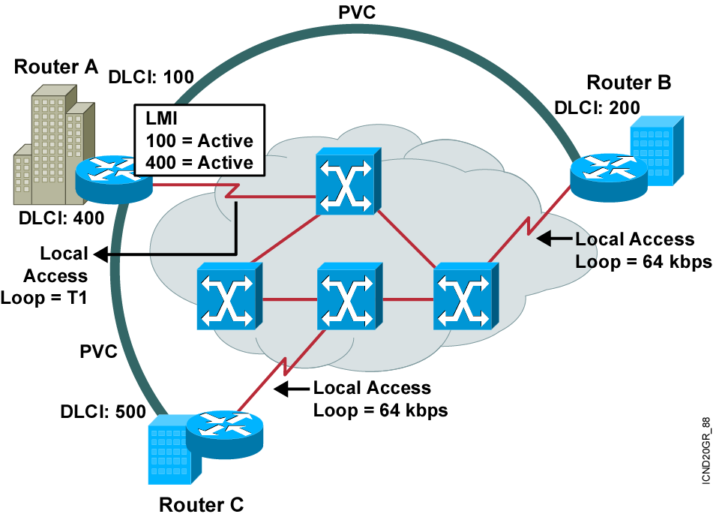
Frame Relay Terminology
Notes:
Purpose: This figure provides an overview of terminology so that the student is prepared to understand the Frame Relay operation discussion.
The terminology used with Frame Relay varies by service provider. These are the commonly used terms.
Point out the local access loop and note that the local access rate is different than the rate used within the Frame Relay cloud.
The DLCI is of local significance, therefore, point out that the same DLCI can be used in multiple places in the network.
The autosensing LMI is a Release 11.2 or later feature.
Frame Relay connections are made using PVCs. The circuits are identified by the DLCI assigned by the service provider.
Reference: For more information on Frame Relay, including a Frame Relay glossary, refer to the Frame Relay Forum World Wide Web page:
http://www.frforum.com/4000/4003.html
This course does not discuss Frame Relay traffic flow issues. Terms like BECN, FECN, and discard eligible are not discussed in this course. These terms are some of the terms that can be found in the Frame Relay Forum’s glossary. The BCRAN discusses Frame Relay traffic flow issues.

Slide 9
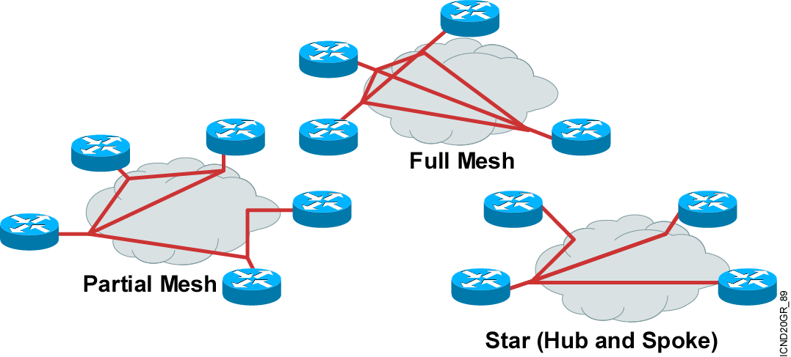
Selecting a Frame Relay Topology
  Frame Relay default: nonbroadcast, multiaccess (NBMA)
Notes:
Purpose: This figure is a transition discussion to illustrate the need for subinterfaces. Now that students are familiar with the concept and configuring of Frame Relay, they are ready to consider the issues and solutions related to broadcast updates in an NBMA Frame Relay network.
Emphasize: Compare the different topologies described.
Explain that by default, interfaces that support Frame Relay are multipoint connection types. This type of connection is not a problem when only one PVC is supported by a single interface; but it is a problem when multiple PVCs are supported by a single interface. In this situation, broadcast routing updates received by the central router cannot be broadcast to the other remote sites.
Broadcast routing updates are issued by distance vector protocols. Link-state and hybrid protocols use multicast and unicast addresses.

Slide 10
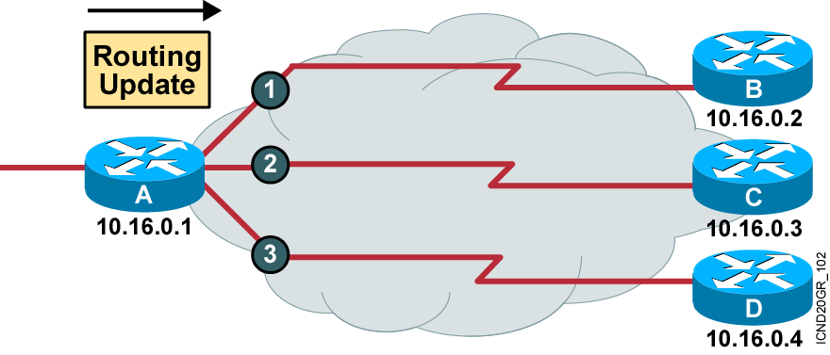
Reachability Issues with Routing Updates
Problem:
  Broadcast traffic must be replicated for
  each active connection.
  Split-horizon rule prevents routing updates received on
  one interface from being forwarded out the same interface.
Notes:
Purpose: This figure continues the discussion that leads into the need for subinterfaces.
Emphasize: Partial mesh Frame Relay networks must deal with the case of split horizon not allowing routing updates to be retransmitted on the same interface from which they were received. Split-horizon cannot be disabled for certain protocols such as AppleTalk.
Split-horizon issues are overcome through the use of logical subinterfaces assigned to the physical interface connecting to the Frame Relay network.
A physical interface can be divided into multiple, logical interfaces. Each logical interface is individually configured and is named after the physical interface. A decimal number is included to distinguish it.
The logical port names contain a decimal point and another number indicating these are subinterfaces of interface serial 0 (S0).
Subinterfaces are configured by the same configuration commands used on physical interfaces.
A broadcast environment can be Frame Relay-created by transmitting the data on each individual circuit. This simulated broadcast requires significant buffering and CPU resources in the transmitting router, and can result in lost user data because of contention for the circuits.
Reference: Interconnections by Radia Perlman is also a good reference on split horizon.
Note: Subinterfaces are particularly useful in a Frame Relay partial-mesh NBMA model that uses a distance vector routing protocol.
Instead of migrating to a routing protocol that supports turning off split horizon, subinterfaces can be used to overcome the split-horizon problem.

Slide 11
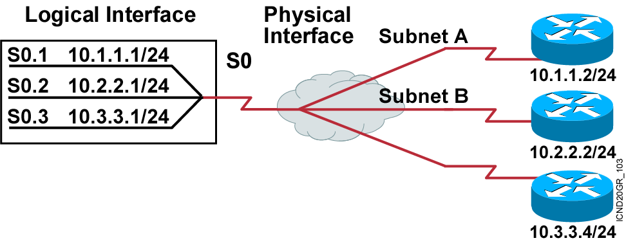
Resolving Reachability Issues
Split horizon can cause problems in NBMA environments.
Subinterfaces can resolve split horizon issues.
Solution: A single physical interface simulates multiple logical interfaces.
Notes:
Purpose: This figure defines subinterfaces and how they can resolve NBMA issues.
Emphasize: You can have connectivity problems in a Frame Relay network if the following conditions exist:
You are using an NBMA model.
Your configuration is in a partial mesh.
You are using a distance vector routing protocol.
Split-horizon is enabled on the routing protocol.
If the routing protocol is configured with split-horizon, routing updates from one router connected on the multipoint subinterface are not propagated to other routers connected on this multipoint subinterface. For example, if router C sends a routing update, this split horizon will keep this update from being sent back out the subinterface to router D.
To resolve this problem you can do the following:
Use Frame Relay subinterfaces to overcome the split-horizon problem.
Use a routing protocol that supports disabling split-horizon.
Use this configuration if you want to save IP address space.
You can also use this type of configuration with several fully meshed groups. Routing updates will be exchanged between the fully meshed routers.
Note: When an interface is assigned “encapsulation frame-relay,” split horizon is disabled for IP and enabled for IPX and AppleTalk, by default.

Slide 12
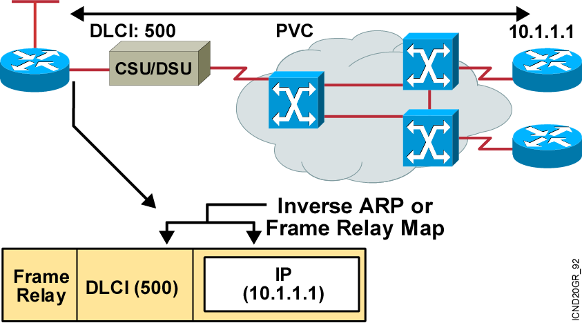
Frame Relay Address Mapping
  Use LMI to get locally significant DLCI from the Frame Relay switch.
  Use Inverse ARP to map the local DLCI to the remote router’s network layer address.
Notes:
Purpose: This figure illustrates mapping the data-link connection identifier (DLCI) to the network-layer address such as IP.
Emphasize: The DLCI is of local significance, therefore, point out that the same DLCI can be used in multiple places in the network. Frame Relay connections are made using PVCs. The circuits are identified by the DLCI assigned by the service provider.
Explain what Inverse ARP is used for. Static mapping can be configured instead of Inverse ARP.

Slide 13
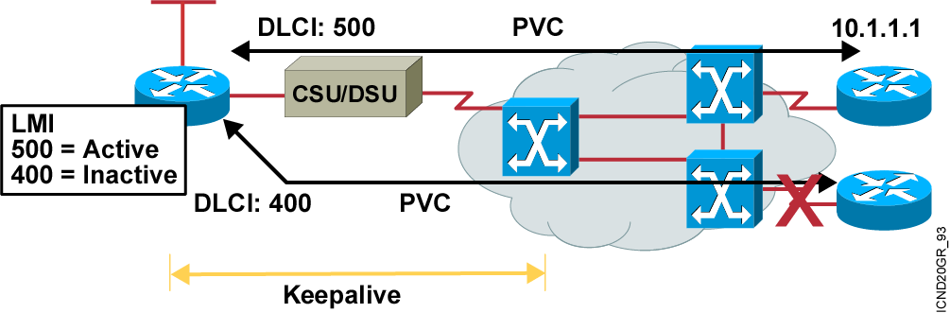
Frame Relay Signaling
  Cisco supports three LMI standards:
    Cisco
    ANSI T1.617 Annex D
    ITU-T Q.933 Annex A
Notes:
Purpose: This figure describes the Local Management Interface (LMI) and shows the key standards.
Emphasize: Explain LMI.
Note: Other key American National Standards Institute (ANSI) standards are T1.606, which defines the Frame Relay architecture, and T1.618, which describes data transfer.
Other key International Telecommunication Union Telecommunication Standardization Sector (ITU-T) specifications include I.122, which defines ITU-T Frame Relay architecture, and Q.922, which standardizes data transfer. Use of these LMI standards is especially widespread in Europe.
The original “gang of four” no longer exists; StrataCom® merged with Cisco, and Digital Equipment Corporation was acquired by Compaq Computers.

Slide 14
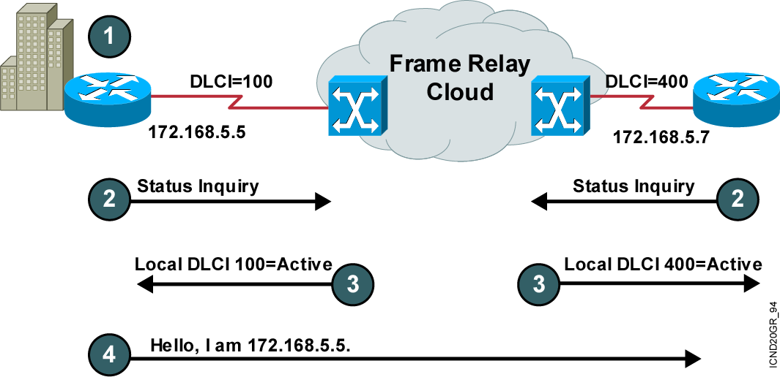
Frame Relay Inverse ARP and LMI Signaling
Notes:
Layer 4 of 4
Purpose: This figure describes the Inverse ARP and LMI process.
Emphasize: Step 1—Indicates that each router must connect to the Frame Relay switch.
Step 2—Discusses what information is sent from the router to the Frame Relay switch.
Step 3—Discusses what the Frame Relay switch does with the received information.
Step 4—Discusses the sending of Inverse ARP messages.

Slide 15
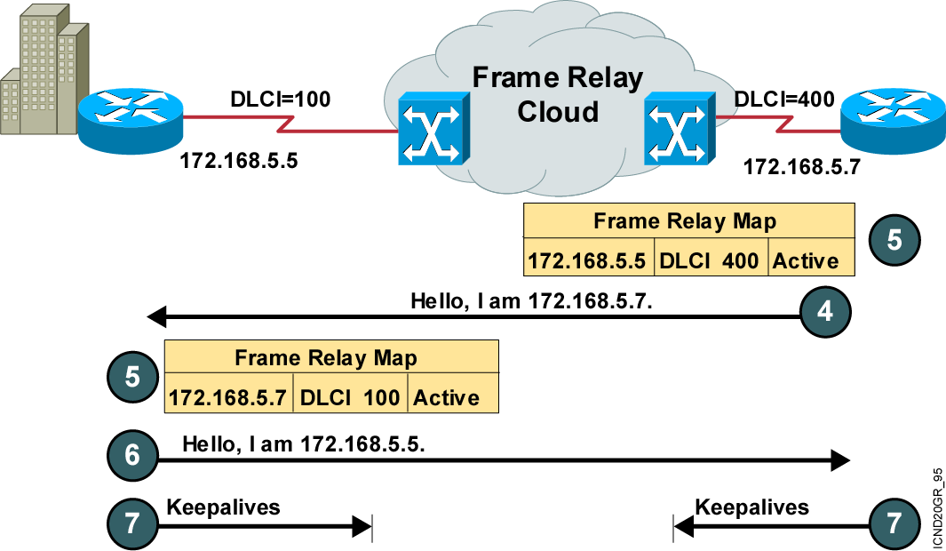
Stages of Inverse ARP and LMI Operation
Notes:
Layer 3 of 3
Purpose: This figure describes the Inverse ARP and LMI process.
Emphasize: Step 5—Discusses how the Inverse ARP message is used to create the Frame Relay map table dynamically.
Step 6—Shows how Inverse ARP has a periodic interval.
Step 7—Discusses the periodic interval for keepalive messages. It’s an LMI function.
Transition: The next section explains how to configure Frame Relay.

Slide 16
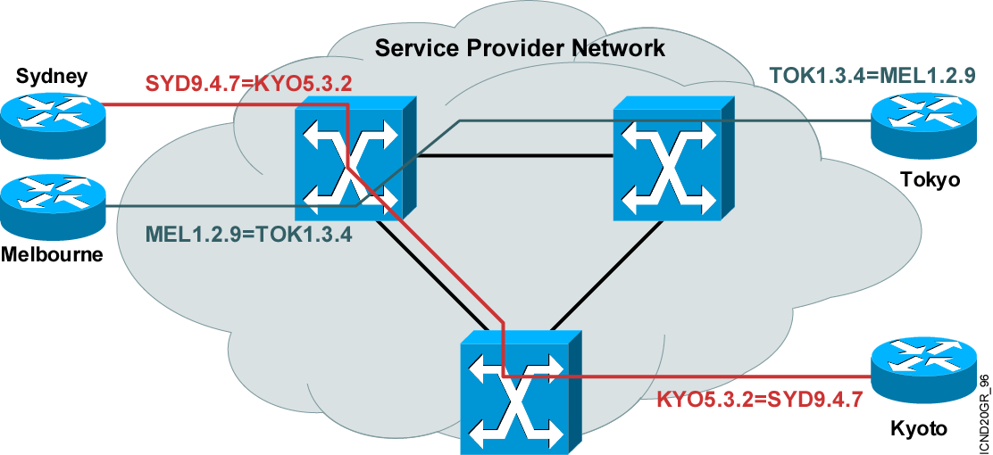
How Service Providers Map Frame Relay DLCIs: Service Provider View

Slide 17
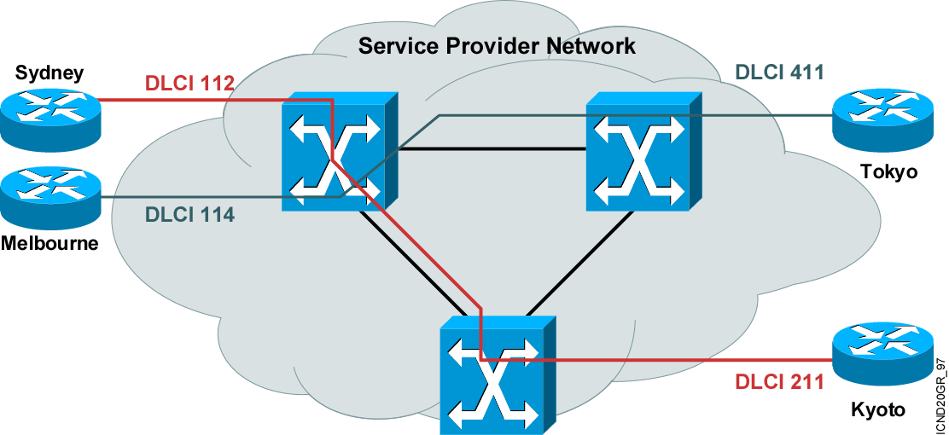
How Service Providers Map Frame Relay DLCIs: Enterprise View

Slide 18
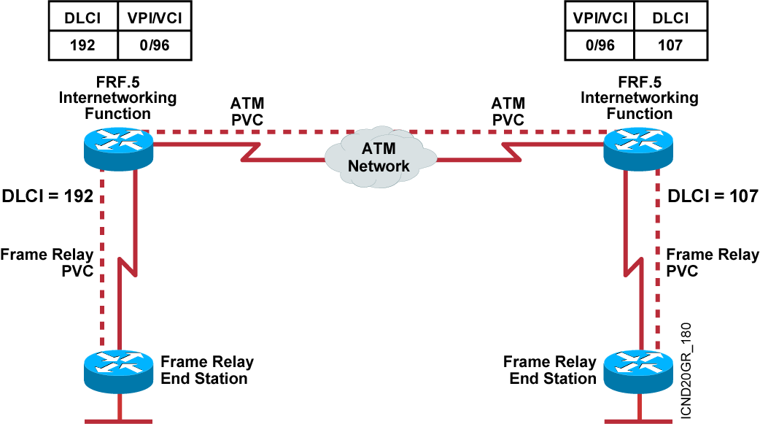
Service Provider
Frame Relay-to-ATM Interworking

Slide 19
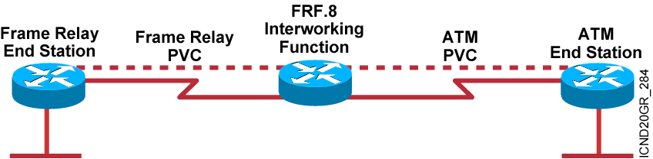
FRF.8 Service Interworking

Slide 20
Summary
  Frame Relay is an ITU-T and ANSI standard that defines the process for sending data over a public data network.
  The core aspects of Frame Relay function at the lower two layers of the OSI reference model.
  Knowing the terms that are used frequently when discussing Frame Relay is important to understanding the operation and configuration of Frame Relay services.
  Frame Relay allows you to interconnect your remote sites in a variety of topologies including star, full mesh, and partial mesh.
  A Frame Relay NBMA topology may cause routing update reachability issues, which are solved by using subinterfaces.

Slide 21
Summary (Cont.)
  A Frame Relay connection requires that, on a VC, the local DLCI be mapped to a destination network layer address such as an IP address.
  LMI is a signaling standard between the router and the Frame Relay switch that is responsible for managing the connection and maintaining status between the devices.
  Service providers map Frame Relay DLCIs so that DLCIs with local significance appear at each end of a Frame Relay connection.
  FRF.5 provides network interworking functionality that allows Frame Relay end users to communicate over an intermediate ATM network that supports FRF.5. FRF.8 provides service interworking functionality that allows a Frame Relay end user to communicate with an ATM
  end user.

Slide 22
